Slide 1
Homework 1 - reminder
Choose and research two of the top cloud service providers. Create a comparison that covers the following aspects:
Pricing models and cost structures
Available services (categorize into IaaS, PaaS, SaaS, …)
Cases of companies using each provider (links)
Submission:
Submit your compiled list in a well-organized document
Submit to the Blackboard by November 19th

Slide 2
Homework 2- reminder
Evaluate the pros and cons of cloud service providers you researched in Homework 1 and make a recommendation for a hypothetical business use case
Submission:
Submit your compiled list in a well-organized document
Submit to the Blackboard by November 19th

Slide 3
Report on hot topics in cloud computing
Submit to the Blackboard by December 21st December 31st

Slide 4
COMP3050 Cloud Computing Technology

Slide 5

Topic 4: Cloud Computing Standardization and Reference Architecture

Slide 6
Cloud Computing Standardization and Reference Architecture
Standardization of cloud computing
Cloud Computing Reference Architecture
Cloud computing standards and laws in China
Cloud computing adoption issues

Slide 7
Cloud Computing Standardization and Reference Architecture
Standardization of cloud computing
Cloud Computing Reference Architecture
Cloud computing standards and laws in China
Cloud computing adoption issues

Slide 8
Standardization of cloud computing

Slide 9
Review

Slide 10
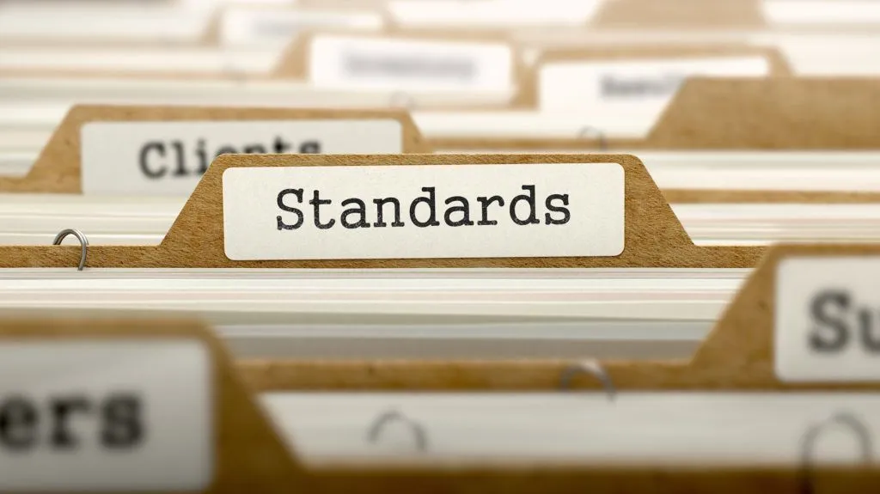
Standardization
The implementation of standards in industry

Slide 11
Standard
As defined by ISO
“A standard is a document, established by a consensus of subject matter experts and approved by a recognized body that provides guidance on the design, use or performance of materials, products, processes, services, systems or persons”.

Slide 12



International standard organizations
ISO
International Organization for Standardization
ITU
International Telecommunication Union
IEC
International Electrotechnical Commission

Slide 13
Where are cloud computing standards developed?
The main technical committees active in Cloud Computing standardization
ISO/IEC JTC 1/SC 38 “Cloud Computing and Distributed Platforms”
ITU-T/SG 13 “Future networks and emerging network technologies”
ISO/IEC JTC 1/SC 27 “Information security, cybersecurity and privacy protection”
ITU-T/SG 17 “Security”

Slide 14
ISO/IEC JTC 1/SC 38 collaborations
SO/IEC JTC 1/SC 38 subcommittee works closely with
other JTC 1 subcommittees
external forums
…

Slide 15
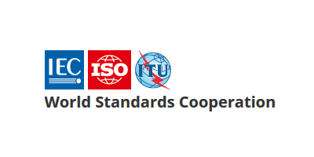
Collaborations
ISO/IEC JTC 1/SC 38 (specifically WG 3: Cloud Computing) and ITU-T/SG 13 formed collaborative teams
Collaborative Team on Cloud Computing Overview and Vocabulary (CT-CCVOCAB)
developed standard ISO/IEC JTC 1 17788 – Cloud Computing Vocabulary
Collaborative Team on Cloud Computing Reference Architecture (CT-CCRA)
developed standard ISO/IEC JTC 1 17789 – Cloud Computing Reference Architecture

Slide 16
Importance of foundational standards
Two foundational standards that deal with vocabulary and reference architecture
ISO/IEC 17788:2014 “Information technology — Cloud computing — Overview and vocabulary”
ISO/IEC 17789:2014 “Information technology — Cloud computing — Reference architecture”.
Essential for developing other standards

Slide 17
Cloud Computing Standardization and Reference Architecture
Standardization of cloud computing
Cloud Computing Reference Architecture
Cloud computing standards and laws in China
Cloud computing adoption issues

Slide 18
Cloud Computing Reference Architecture

Slide 19
Cloud Computing Reference Architecture

Slide 20
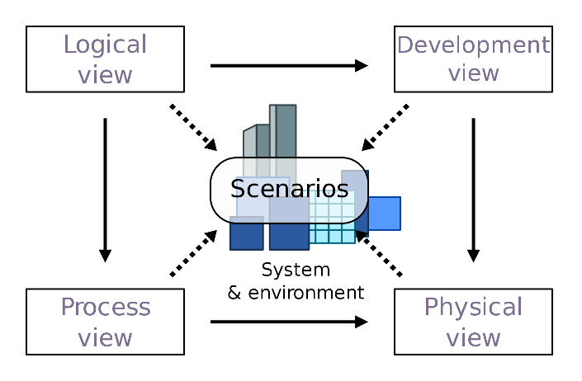
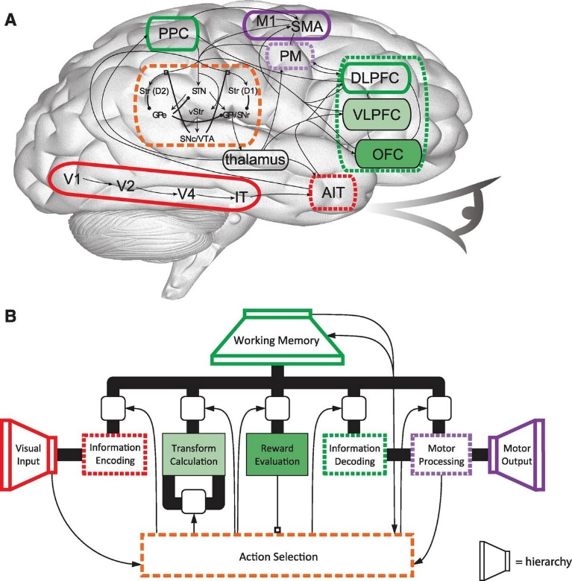
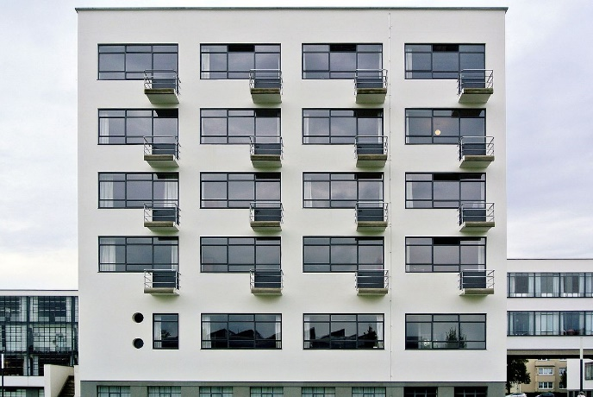
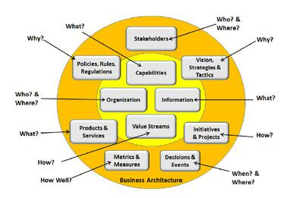
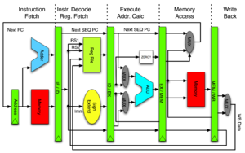
Architecture
The process of planning, designing and constructing structures
Building
Business
Cognitive
Computer
Software
…..

Slide 21
What is Architecture?
The architecture of a system is the set of structures needed to reason about the system, which comprise elements, relations among them, and properties of both.

Slide 22
What is Architecture?
The architecture of a system is the set of structures needed to reason about the system, which comprise elements, relations among them, and properties of both.

Slide 23
Reference Architecture
A reference architecture provides a template solution for an architecture for a particular domain
It also provides a common vocabulary with which to discuss implementations, often with the aim to stress commonality
It refers to any system in this domain
Not to a specific implementation of the system

Slide 24
Cloud Computing Reference Architecture
Defines the basic building blocks—architectural elements and their relationships—which make up the cloud
Cloud computing roles
Cloud computing activities
Cloud computing functional components and their relationships

Slide 25
How would you attempt to describe a cloud computing reference architecture?

Slide 26
Standards describing CCRA
Before 2010, cloud computing reference models were proposed by multiple cloud organizations, vendors, and federal agencies
Example: 2010 – CCRA developed by IBM
In 2011 CCRA developed by NIST was published
The team from NIST surveyed and completed an initial analysis of existing cloud computing reference models and developed a neutral model of architectural concepts
In 2014 ISO together with IEC published an international standard describing CCRA

Slide 27
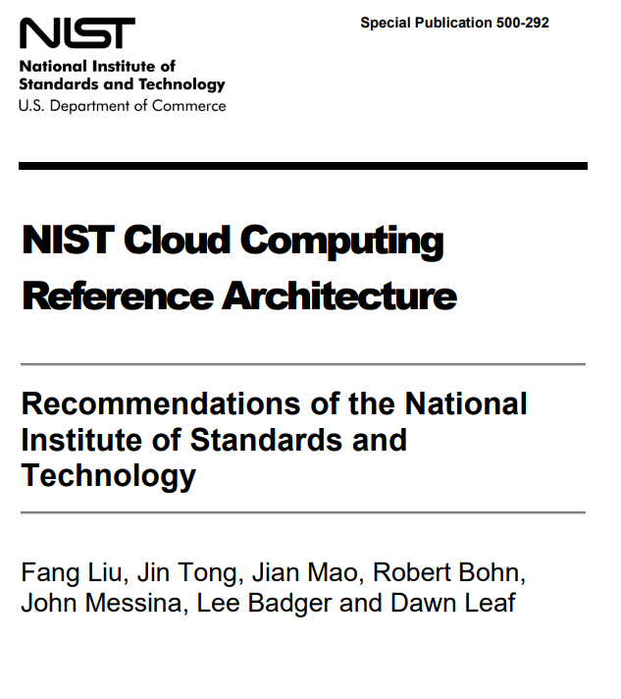
CRRA developed by NIST
NIST - National Institute of Standards and Technology
SP 800-145: The NIST Definition of Cloud Computing
SP 800-146: Cloud Computing Synopsis and Recommendations
SP 500-292: NIST Cloud Computing Reference Architecture

Slide 29
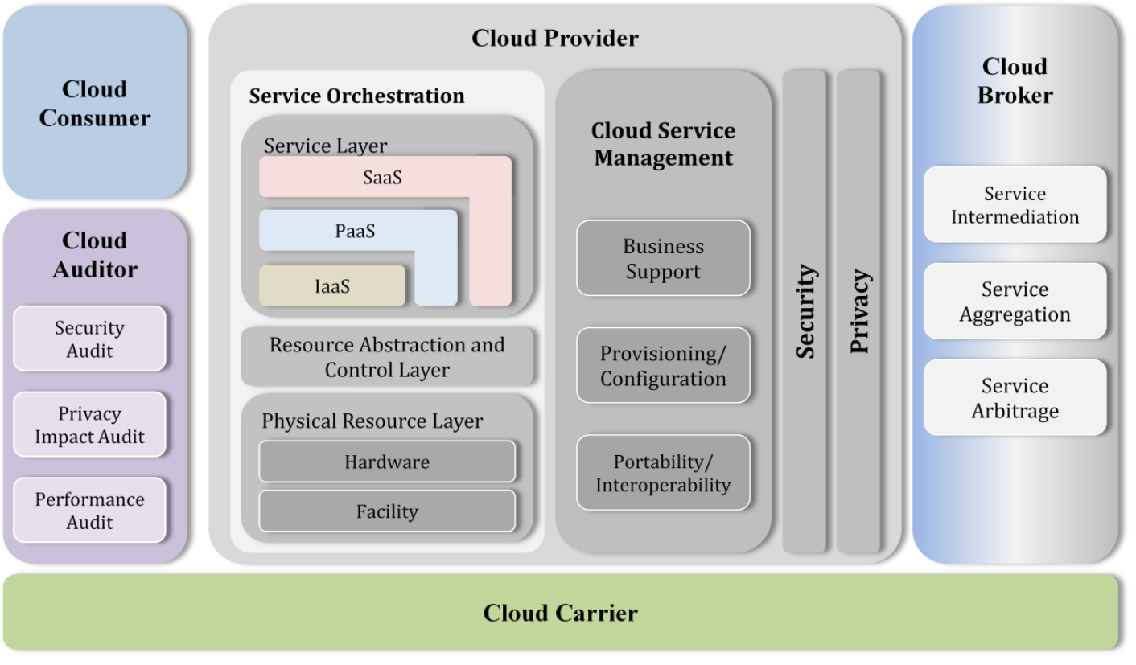
Overview of NIST CCRA

Slide 30
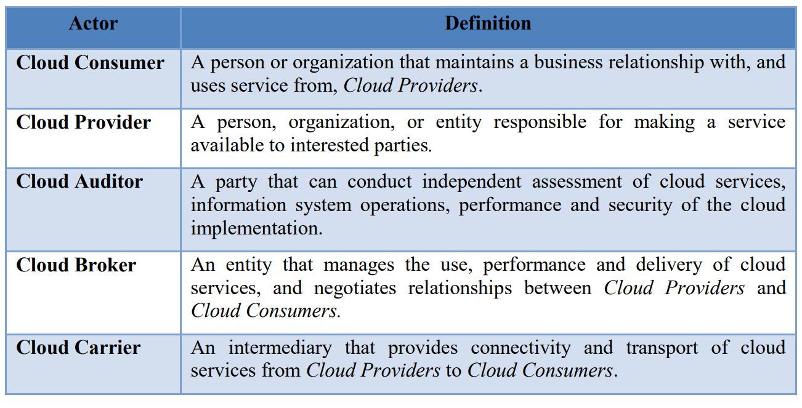
Cloud computing actors

Slide 31
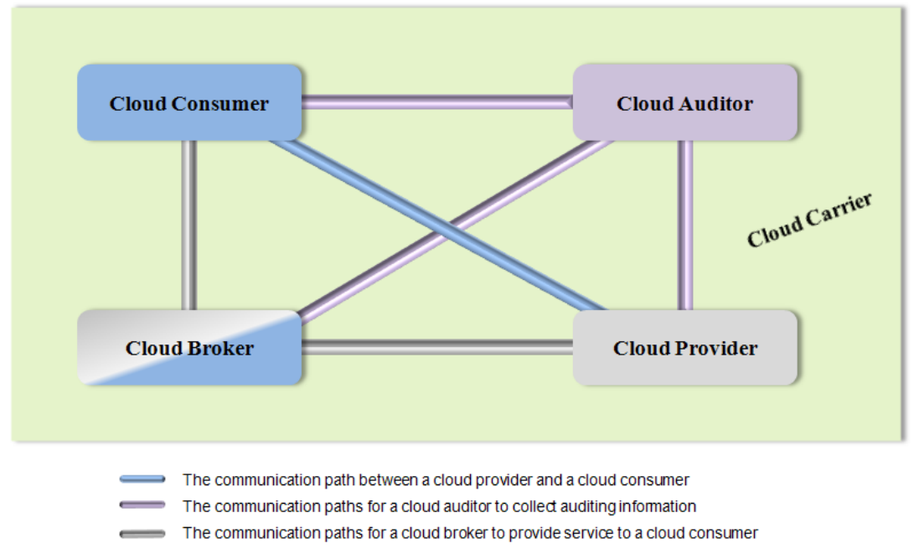
Interactions between the actors

Slide 32
Task
We mentioned earlier that foundational standards (such as the standard we are studying now) are essential for developing other standards
While learning about the content of the standard describing cloud computing reference architecture try to think how could this standard be helpful when developing other standards

Slide 33
Cloud consumer
The cloud consumer is the principal stakeholder for the cloud computing service
A cloud consumer represents a person or organization that maintains a business relationship with and uses the service from a cloud provider
A cloud consumer browses the service catalog from a cloud provider, requests the appropriate service, sets up service contracts with the cloud provider, and uses the service
The cloud consumer may be billed for the service provisioned, and needs to arrange payments accordingly

Slide 34
Cloud consumers
SaaS Consumer
PaaS Consumer
IaaS Consumer

Slide 35
SaaS consumer types
Organizations
provide their members with access to software applications
End users
directly use software applications
Software application administrators
configure applications for end users

Slide 36
SaaS consumer - billing
SaaS consumers can be billed based on
the number of end users
the time of use
the network bandwidth consumed
the amount of data stored
duration of stored data

Slide 37
PaaS consumer types
Application developers
design and implement application software
Application testers
run and test applications in cloud-based environments
Application deployers
publish applications into the cloud
Application administrators
configure and monitor application performance on a platform

Slide 38
PaaS consumer - billing
PaaS consumers can be billed based on
processing
database storage
network resources consumed by the PaaS application
the duration of the platform usage

Slide 39
IaaS consumer types
System developers, system administrators and IT managers
create, install, manage and monitor services for IT infrastructure operations

Slide 40
IaaS consumer - billing
IaaS consumers can be billed based on the amount or duration of the resources consumed, such as
CPU hours used by virtual computers
volume and duration of data stored
network bandwidth consumed
number of IP addresses used for certain intervals
...

Slide 41
Cloud provider
A cloud provider is a person, an organization; it is the entity responsible for making a service available to interested parties.
A Cloud Provider acquires and manages the computing infrastructure required for providing the services, runs the cloud software that provides the services, and makes arrangement to deliver the cloud services to the Cloud Consumers through network access.

Slide 42
Cloud providers
SaaS Provider
PaaS Provider
IaaS Provider

Slide 43
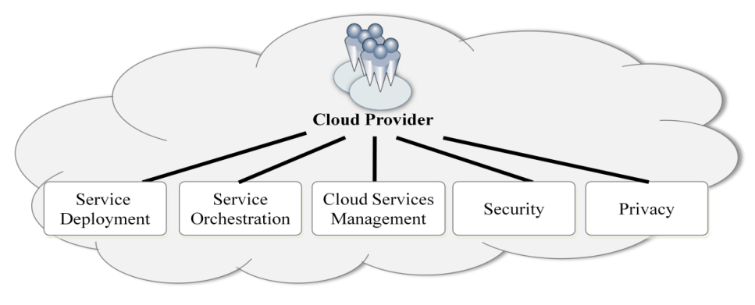
Cloud Provider - Major Activities

Slide 44
Discussion
Based on what we learnt so far, about the content of the standard describing cloud computing reference architecture, how could this standard be used when developing other standards?

Slide 45
Let’s consider these examples of other standards

Slide 46
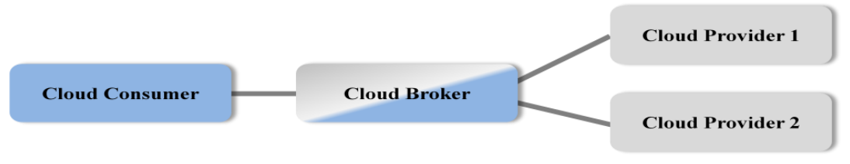
Cloud broker
The integration of cloud services can be too complex for cloud consumers to manage.
A cloud consumer may request cloud services from a cloud broker, instead of contacting a cloud provider directly
A cloud broker is an entity that manages the use, performance and delivery of cloud services and negotiates relationships between cloud providers and cloud consumers

Slide 47
Cloud broker - Service Intermediation
A cloud broker enhances a given service by improving some specific capability and providing value-added services to cloud consumers
managing access to cloud services
identity management
performance reporting
enhanced security
…

Slide 48
Cloud broker - Service Aggregation
A cloud broker combines and integrates multiple services into one or more new service
The broker provides data integration and ensures the secure data movement between the cloud consumer and multiple cloud providers

Slide 49
Cloud broker - Service Arbitrage
A broker has the flexibility to choose services from multiple agencies.
The cloud broker, for example, can use a credit-scoring service to measure and select an agency with the best score

Slide 50
Cloud carrier
Cloud carriers provide the connectivity and transport of cloud services from cloud providers to cloud consumers.
A cloud provider participates in and arranges for two unique service level agreements (SLAs), one with a cloud carrier (e.g. SLA2) and one with a cloud consumer (e.g. SLA1)

Slide 51
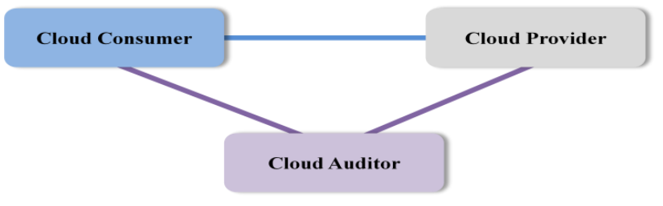
Cloud auditor
A party that can perform an independent examination of cloud service controls with the intent to express an opinion thereon
Audits are performed to verify conformance to standards through review of objective evidence
A cloud auditor can evaluate the services provided by a cloud provider in terms of security controls, privacy impact, performance, etc.

Slide 52
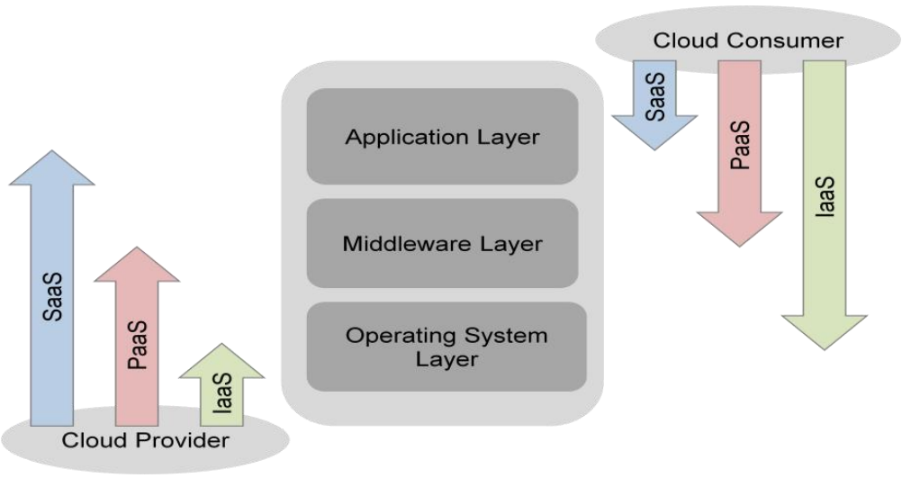
Scope of Controls between Provider and Consumer

Slide 53
Application layer
Software applications targeted at end users or programs
applications are used by SaaS consumers and installed/managed/maintained by SaaS providers
applications that are installed/managed/maintained by PaaS consumers
applications that are installed/managed/maintained by IaaS consumers

Slide 54
Middleware layer
Provides software building blocks (e.g., libraries, database, and Java virtual machine) for developing application software in the cloud
used by PaaS consumers
installed/managed/maintained by IaaS consumers
installed/managed/maintained by IaaS consumers by PaaS providers
hidden from SaaS consumers

Slide 55
OS layer
Includes operating system and drivers
hidden from SaaS consumers
hidden from PaaS consumers
An IaaS cloud allows one or multiple guest OS‟s to run virtualized on a single physical host.
IaaS consumers have broad freedom to choose which OS to be hosted among all the OS‟s that could be supported by the cloud provider
The IaaS consumers should assume full responsibility for the guest OS‟s,
IaaS provider controls the host OS

Slide 56
SaaS services
Email and Office Productivity: Applications for email, word processing, spreadsheets, presentations, etc.
Billing: Application services to manage customer billing based on usage and subscriptions to products and services.
Customer Relationship Management (CRM): CRM applications that range from call center applications to sales force automation.
Collaboration: Tools that allow users to collaborate in workgroups, within enterprises, and across enterprises

Slide 57
SaaS services
Content Management: Services for managing the production of and access to content for web-based applications.
Document Management: Applications for managing documents, enforcing document production workflows, and providing workspaces for groups or enterprises to find and access documents.
Financials: Applications for managing financial processes ranging from expense processing and invoicing to tax management.
Human Resources: Software for managing human resources functions within companies.

Slide 58
SaaS services
Sales: Applications that are specifically designed for sales functions such as pricing, commission tracking, etc.
Social Networks: Social software that establishes and maintains a connection among users that are tied in one or more specific types of interdependency.
Enterprise Resource Planning (ERP): Integrated computer-based system used to manage internal and external resources, including tangible assets, financial resources, materials, and human resources.

Slide 59
PaaS Services
Business Intelligence: Platforms for the creation of applications such as dashboards, reporting systems, and data analysis.
Database: Services offering scalable relational database solutions or scalable non-SQL datastores.
Development and Testing: Platforms for the development and testing cycles of application development, which expand and contract as needed.
Integration: Development platforms for building integration applications in the cloud and within the enterprise.
Application Deployment: Platforms suited for general purpose application development. These services provide databases, web application runtime environments, etc.

Slide 60
IaaS Services
Backup and Recovery: Services for backup and recovery of file systems and raw data stores on servers and desktop systems.
Compute: Server resources for running cloud-based systems that can be dynamically provisioned and configured as needed
Content Delivery Networks (CDNs): CDNs store content and files to improve the performance and cost of delivering content for web-based systems.
Services Management: Services that manage cloud infrastructure platforms. These tools often provide features that cloud providers do not provide or specialize in managing certain application technologies.
Storage: Massively scalable storage capacity that can be used for applications, backups, archival, and file storage

Slide 61
Service deployment models
A cloud infrastructure may be operated in one of the following deployment models
public cloud
private cloud
community cloud
hybrid cloud
The differences are based on how exclusive the computing resources are made to a Cloud Consumer

Slide 62
Public cloud
A cloud in which the cloud infrastructure and computing resources are made available to the general public over a public network
Owned by an organization selling cloud services, and serves a diverse pool of clients

Slide 63
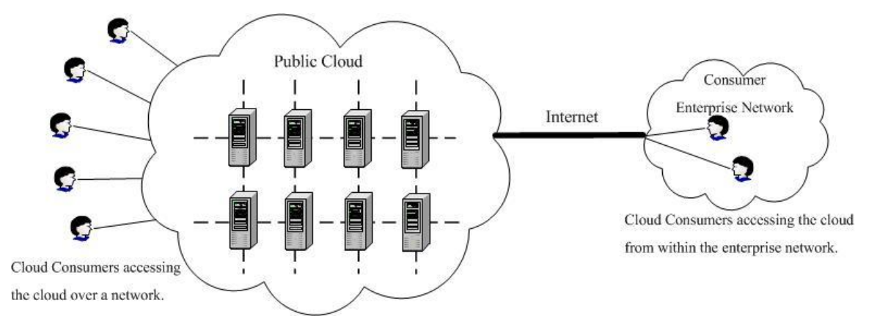
Public cloud

Slide 64
Private cloud
A cloud that gives a single Cloud Consumer’s organization the exclusive access to and usage of the infrastructure and computational resources
It may be managed either by the Cloud Consumer organization or by a third party
on-site private clouds - hosted on the organization’s premises
outsourced private clouds - outsourced to a hosting company

Slide 65
On-site private cloud
Hosted on the organization’s premises

Slide 66
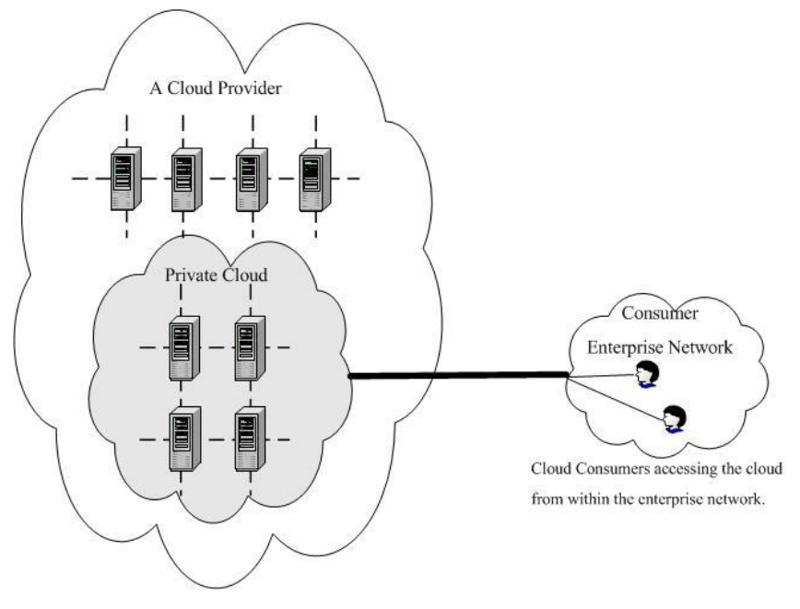
Outsourced private cloud
Outsourced to a hosting company

Slide 67
Community cloud
A community cloud serves a group of Cloud Consumers which have shared concerns such as mission objectives, security, privacy and compliance policy
May be managed by the organizations or by a third party
on-site community cloud - implemented on customer premise
outsourced community cloud - outsourced to a hosting company

Slide 68
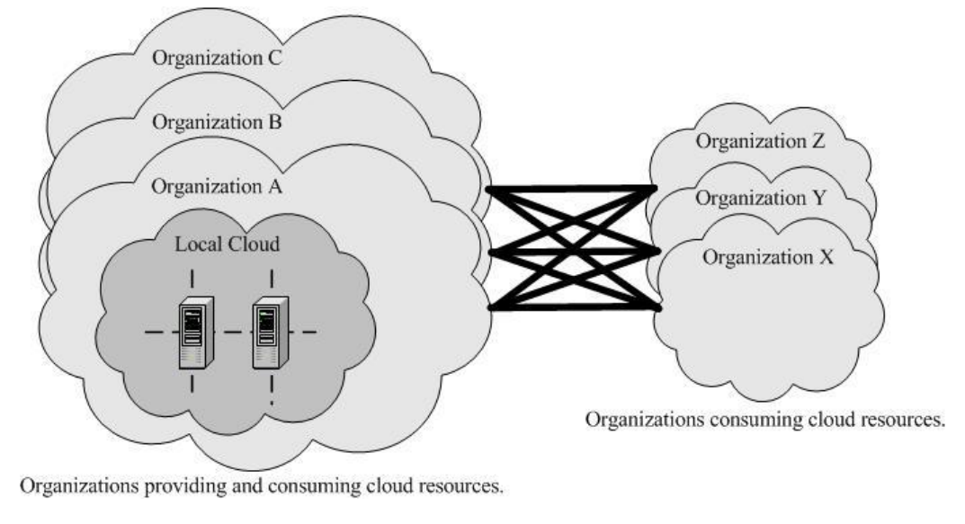
On-site community cloud

Slide 69
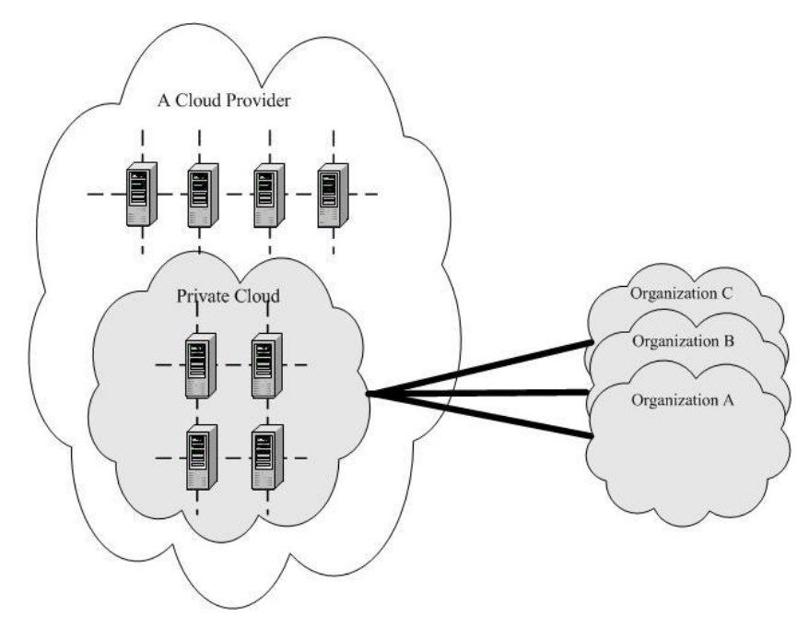
Outsourced community cloud

Slide 70
Hybrid cloud
A composition of two or more clouds (on-site private, on-site community, off-site private, off-site community or public)
The clouds remain as distinct entities but are bound together by standardized or proprietary technology that enables data and application portability

Slide 71
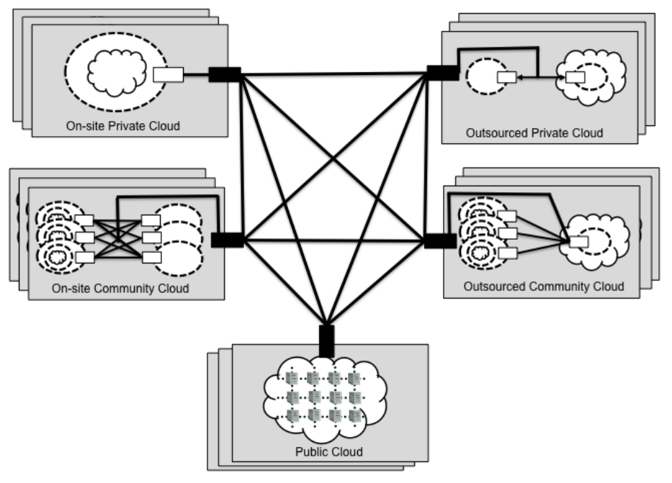
Hybrid cloud

Slide 73
CCRA developed by ISO
ISO/IEC 17789:2014, Cloud computing – Reference architecture
diagrams and descriptions of how various aspects of cloud computing relate to one another and includes cloud computing roles, activities and functional components and their relationships.
This standard was last reviewed and confirmed in 2021.

Slide 74
ISO/IEC 17789:2014 CCRA goals
to describe the community of stakeholders for cloud computing;
to describe the fundamental characteristics of cloud computing systems;
to specify basic cloud computing activities and functional components, and describe their relationships to each other and to the environment;
to identify principles guiding the design and evolution of the CCR

Slide 75
ISO/IEC 17789:2014 CCRA standardization objectives
to enable the production of a coherent set of international standards for cloud computing;
to provide a technology-neutral reference point for defining standards for cloud computing;
to encourage openness and transparency in the identification of cloud computing benefits and risks.

Slide 76
ISO/IEC 17789:2014 CCRA architectural views
Cloud computing systems are described using a viewpoint approach

Slide 77
What is a viewpoint approach?
A view is a representation of a whole system from the perspective of a related set of concerns
Architecture description practices utilize multiple views to address several areas of concerns, each one focusing on a specific aspect of the system

Slide 78
ISO/IEC 17789:2014 CCRA views
User view and functional view - addressed within this standard
Implementation and deployment views - out of the scope of this standard
Dependant on vendor-specific cloud computing implementations and actual deployments

Slide 79
ISO/IEC 17789:2014 CCRA views
User view and functional view - addressed within this standard
Implementation and deployment views - out of the scope of this standard
Dependant on vendor-specific cloud computing implementations and actual deployments

Slide 80
User view

Slide 81
User view
cloud computing activities
roles and sub-roles
parties
cloud services
cloud deployment models
cross-cutting aspects

Slide 82
User view
cloud computing activities
roles and sub-roles
parties
cloud services
cloud deployment models
cross-cutting aspects

Slide 83
User view - exercise
cloud computing activities
roles and sub-roles
parties
cloud services
cloud deployment models
cross-cutting aspects

Slide 84
Cross-cutting aspects
both architectural and operational considerations
shared issues across the roles, activities and functional components
can you think of one example of cross-cutting aspect?

Slide 85
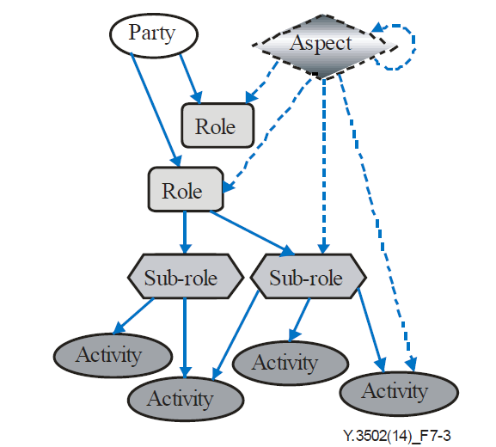
User view entities

Slide 86
Parties
large corporations
small and medium sized enterprises
government departments
academic institutions
private citizens
…

Slide 87
User view entities

Slide 88
Cloud computing roles

Slide 89
Cloud computing roles
cloud service customer (CSC)
A party which is in a business relationship for the purpose of using cloud services

Slide 90
Cloud computing roles
cloud service provider (CSP)
A party which makes cloud services available

Slide 91
Cloud computing roles
cloud service partner (CSN)
A party which is engaged in support of, or auxiliary to, activities of either the cloud service provider or the cloud service customer, or both

Slide 92
User view entities

Slide 93
Roles and sub-roles

Slide 94
Roles and sub-roles

Slide 95
Roles and sub-roles

Slide 96
Roles and sub-roles

Slide 97
User view entities

Slide 98
Cloud computing activities relating to cloud service customer sub-roles

Slide 99
Cloud computing activities relating to cloud service provider sub-roles

Slide 100
Cloud computing activities related to cloud service partner sub-roles

Slide 101
User view
cloud computing activities
roles and sub-roles
parties
cloud services
cloud deployment models
cross-cutting aspects

Slide 102
Cloud services
Cloud capabilities types:
application capabilities type
platform capabilities type
infrastructure capabilities type
Cloud services categories
Infrastructure as a service (IaaS)
Platform as a service (PaaS)
Software as a service (SaaS)
Network as a service (NaaS)

Slide 103
Cloud deployment models
public cloud
private cloud
community cloud
hybrid cloud

Slide 104
Cross-cutting aspects
both architectural and operational considerations
shared issues across the roles, activities and functional components

Slide 105
Cross-cutting aspects
both architectural and operational considerations
shared issues across the roles, activities and functional components
can you think of one example of cross-cutting aspect?

Slide 106
Can you think of one example of cross-cutting aspect?
What is an important issue that all the roles activities and functional components of cloud computing face?

Slide 107
Example of cross-cutting aspects
Security is a cross-cutting aspect
it applies to infrastructure, services, cloud service providers, cloud service customers and cloud service partners
all of these need to be secured, but how they are secured is different based on what is being secured

Slide 108
ISO/IEC 17789:2014 CCRA views
User view and functional view - addressed within this standard
Implementation and deployment views - out of the scope of this standard
Dependant on vendor-specific cloud computing implementations and actual deployments

Slide 109
ISO/IEC 17789:2014 CCRA views
User view and functional view - addressed within this standard
Implementation and deployment views - out of the scope of this standard
Dependant on vendor-specific cloud computing implementations and actual deployments

Slide 110
Functional view

Slide 111
Cloud computing layering framework
The functional architecture is partially layered (i.e., has layers and a set of multi-layer functions)

Slide 112
Layers

Slide 113
Layers
User layer
includes functional components that support the cloud computing activities of cloud service customers and cloud service partners

Slide 114
Layers
Access layer
includes functional components that facilitate function distribution and interconnection

Slide 115
Layers
Service layer
includes functional components that provide the cloud services themselves plus related administration and business capabilities, and the orchestration capabilities necessary to realize them

Slide 116
Layers
Resource layer
includes the functional components that represent the resources needed to implement the cloud computing system

Slide 117
Cloud computing layering framework
Multi-layer functions
include functional components that provide capabilities that are used across multiple functional layers

Slide 118
Functional components of the CCRA

Slide 119
ISO/IEC 17789:2014 CCRA views
User view and functional view - addressed within this standard
Implementation and deployment views - out of the scope of this standard
Dependant on vendor-specific cloud computing implementations and actual deployments

Slide 120
ISO/IEC 17789:2014 CCRA views
User view and functional view - addressed within this standard
Implementation and deployment views - out of the scope of this standard
Dependant on vendor-specific cloud computing implementations and actual deployments

Slide 121
Recall what we said about Reference Architecture
It refers to any system in this domain, not to a specific implementation of the system
Implementation and deployment views of the system are dependent on vendor-specific implementations and actual deployments
They will describe a specific implementation of a system

Slide 122
ISO/IEC 17789:2014 CCRA views
User view and functional view - addressed within this standard
Implementation and deployment views - out of the scope of this standard
Dependant on vendor-specific cloud computing implementations and actual deployments

Slide 123
Cloud Computing Standardization and Reference Architecture
Standardization of cloud computing
Cloud Computing Reference Architecture
Cloud computing standards and laws in China
Cloud computing adoption issues

Slide 124
What Chinese cloud providers do you know?

Slide 125

Chinese cloud providers
Most popular chinese cloud providers
Alibaba Cloud
Tencent Cloud
China Telecom Cloud
Huawei Cloud
Baidu Cloud

Slide 126
Do you know about any international cloud providers in China?

Slide 127
International cloud providers in China
International cloud providers have to operate in the Chinese market by cooperating with domestic service providers
Examples
AWS is run by Sinnet in Beijing and by Ningxia Western Cloud Data Technology (NWCD) in Ningxia
Microsoft Azure is branded as Azure China and operated locally by 21Vianet

Slide 128
Security related regulation
China Cybersecurity Law (CSL) - 2017
all network operators must comply with the CSL
Classified Protection of Cybersecurity Scheme(Multi-Level Protection Scheme (MLPS) - 2008/2019
MLPS was first introduced in 2008 and updated to MLPS 2.0 in 2019
a regulatory scheme designed to protect the cybersecurity of networks and systems in China
it is compulsory for all companies and individuals that own, operate, or provide services relating to network and corresponding system components in China to follow the national standards under the MLPS scheme
China Data Security Law (DSL) - 2021
stipulates the security of data related activities in mainland China such as collection, storage, processing, usage, provision, trading and publishing, etc.

Slide 129
Privacy related regulation
China Personal Information Protection Law (PIPL) – 2021
It is the first law framework over personal data protection in mainland China to protect personal information rights and interests, regulate the processing of personal information, and promote the reasonable use of personal information
regulates the data related activities pertaining to personal data
Other than PIPL, the data protection requirements can also be found in various other regulations

Slide 130
Financial industry standards on cloud computing technology
The National Financial Standardization Technical Committee ('NFSTC') announced, on 27 October 2020, that the People's Bank of China has released three financial industry standards on cloud computing
Technical Framework of Cloud Computing Technology Financial Application Specification (JR/T 0166-2020) ('the Cloud Computing Framework Specification')
Cloud Computing Technology Financial Application Specification Security Technical Requirements (JR/T 0167-2020) ('the Cloud Computing Security Specification')
focuses on the potential risks of cloud computing financial applications
outlines requirements for data security and security management
proposes policies
Cloud Computing Technology Financial Application Specification Disaster Recovery (JR/T 0168-2020) ('Cloud Computing Disaster Recovery Specification')
stipulates technical requirements that all cloud computing participants should follow when measuring the cloud computing platform's disaster tolerance capability and carrying out the disaster recovery work of the cloud computing platform

Slide 131

Standardization Administration of the People's Republic of China (SAC), established in April 2001, is authorized by the State Council to undertake unified management, supervision and overall coordination of standardization work in China
SAC represents China to join
International Organization for Standardization (ISO)
International Electrotechnical Commission (IEC)
other international and regional standardization organizations.

